Slide 1


STUDENT EXAM PERFORMANCE ANALYSIS & GRADE PREDICTION
Toheebat Yewande Tiletile
Data Science Enthusiast

Slide 2
TABLE OF CONTENT
7
1
Predictive modelling
Introduction
8
Conclusion
2
Problem Statement
9
Proposed solution
3
Data Overview
10
4
Tools & Techniques
Data Preprocessing
5
Exploratory Data Analysis (EDA)
11
References
12
6
Question and Answer
Correlation Analysis

Slide 3


INTRODUCTION
This analysis examines student performance across multiple subjects, identifying key patterns and correlations that can inform educational strategies. By leveraging data on scores in subjects such as Math, English, and Computer Science, the analysis provides insights into areas of strength and opportunities for improvement.
The primary objective is to address concerns regarding inconsistent student performance across different classes. Through data-driven insights, we aim to identify factors affecting academic success and propose actionable strategies for enhancement.

Slide 4
PROBLEM STATEMENT
PROBLEM
STATEMENT
A school manager has received multiple complaints regarding inconsistent student performance across different classes. Some classes consistently perform well, while others struggle, leading to concerns about overall academic quality and the effectiveness of teaching methods.
The manager seeks a data-driven solution to assess the performance of each class, identify top-performing classes, and pinpoint those that require intervention.

Slide 5









DATA OVERVIEW
Source: Kaggle open educational dataset
Class
Average Score
Grade
Subject Scores
Age
Gender
Attendance Score
Total Score
Notes:
Data Overview:
The dataset includes key variables such as:
Math, English, and Computer Scores: Reflecting student performance across subjects.
Attendance Score: Capturing student presence, which is a critical factor in performance.
Total and Average Scores: Aggregating performance across all subjects.
Grade: Assigned based on average scores (A, B, C, D, F)

Slide 6
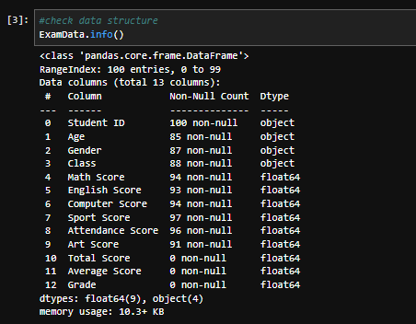
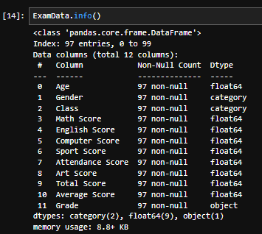
DATA PREPROCESSING
Before preprocessing
Steps Taken
Removed duplicate rows.
Handled missing values (median, mean, mode).
After Preprocessing
Engineered features (grade, total and average scores).
Categorized attendance (low, medium, high).

Slide 7
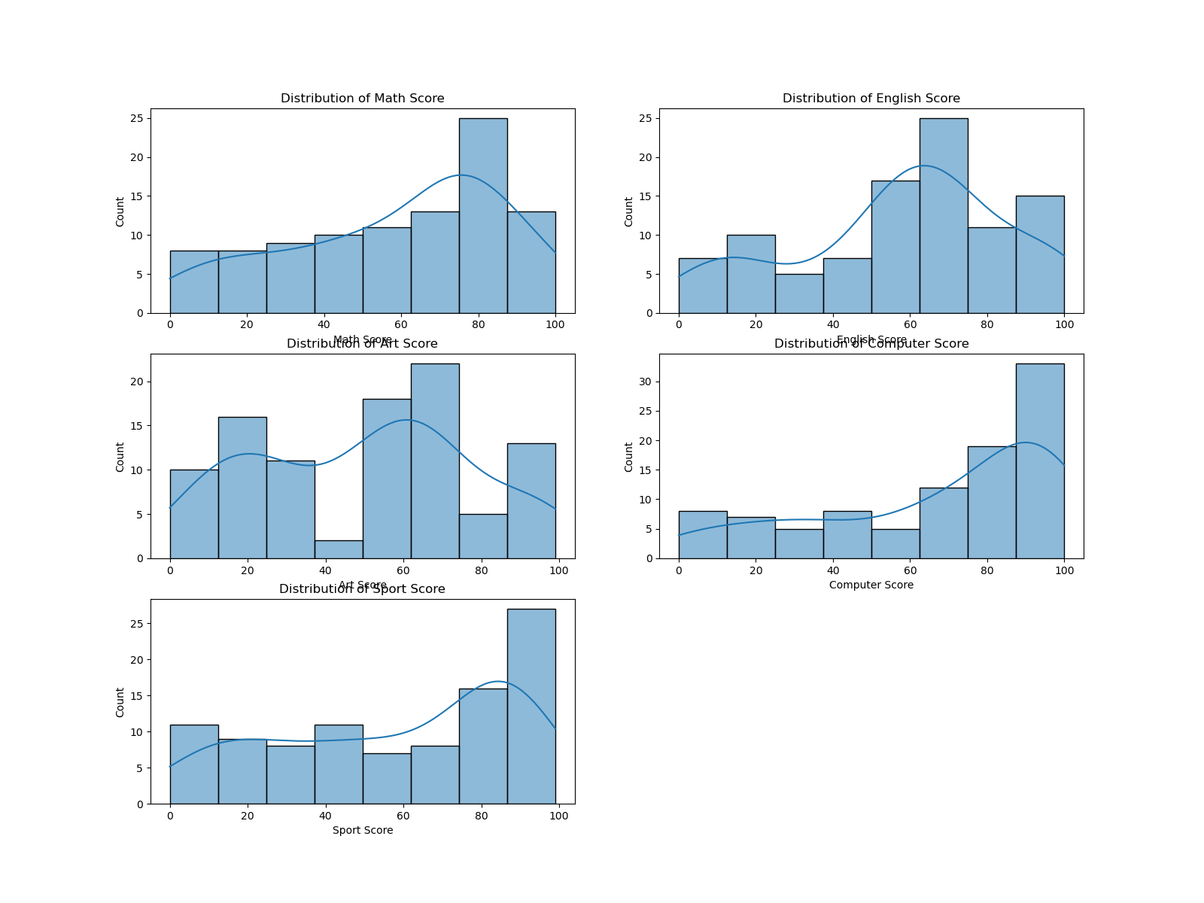
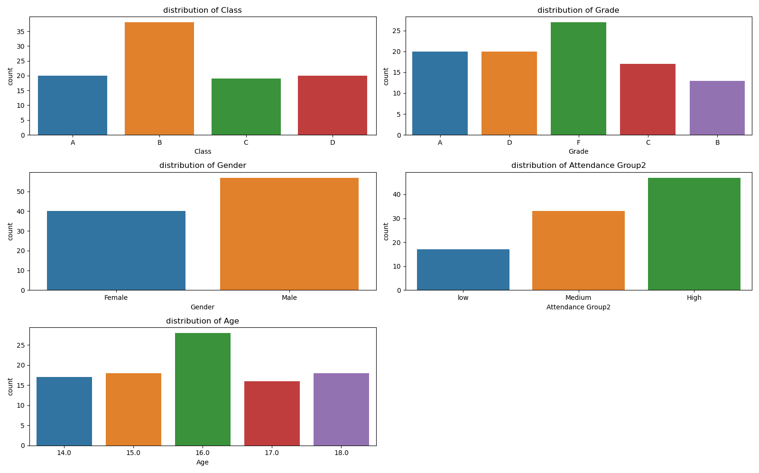
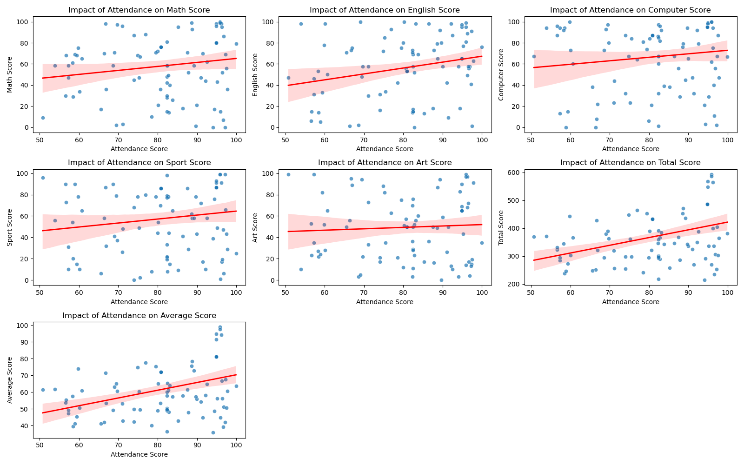
EXPLORATORY DATA ANALYSIS (EDA) - 1
Key Findings
Fig. 2
Fig. 3
Fig. 1
Student Distribution: Class B had the most students; males student outnumbered females students; most common grade was F. The average age of students is 16, with a range from 14 to 18.
Score Distribution: The majority of students scored around the middle, with scores clustering near the average mark. There are outliers at both ends, with a smaller group of students achieving either very high or very low scores.
Attendance Impact: There is a positive correlation between attendance and performance across most subjects.

Slide 8
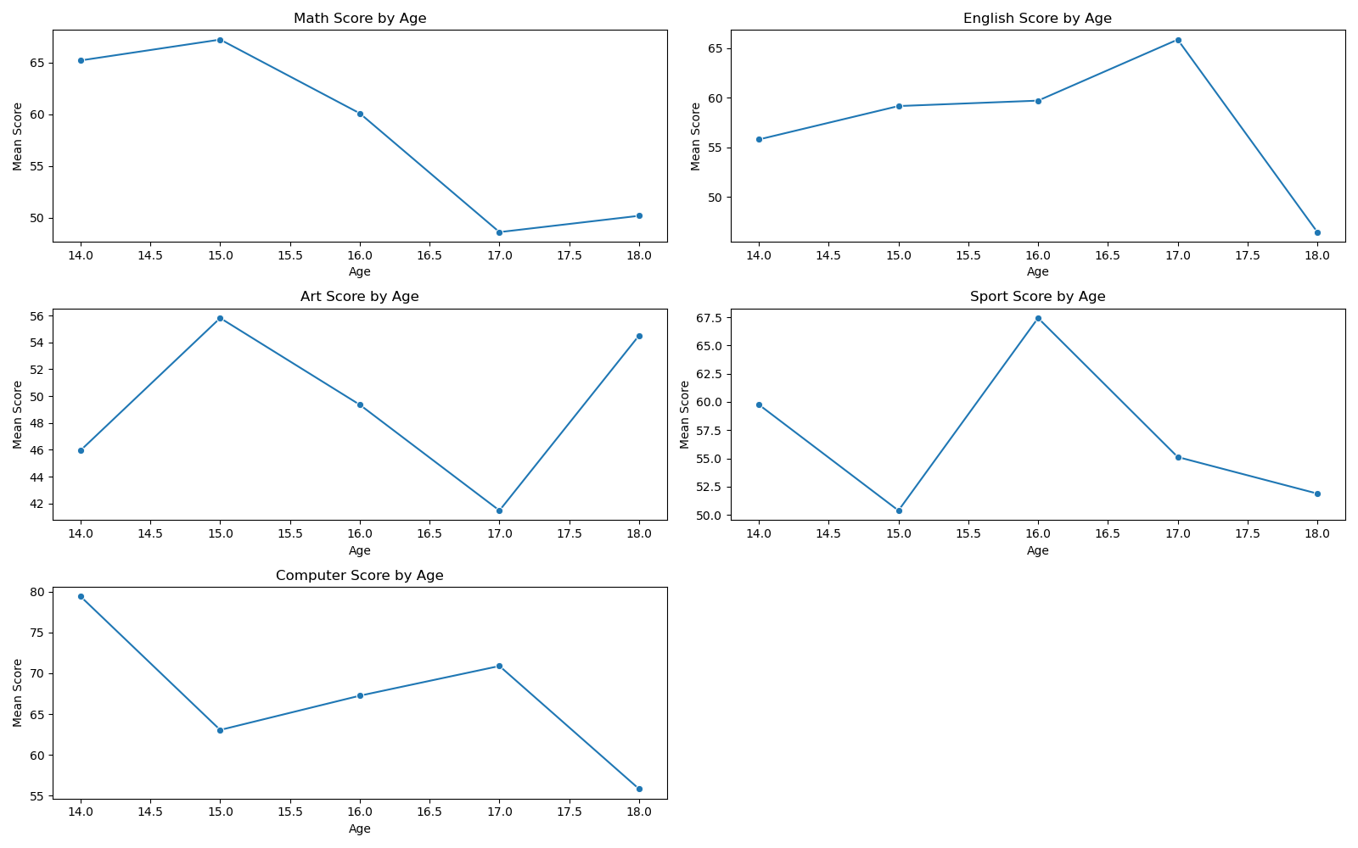
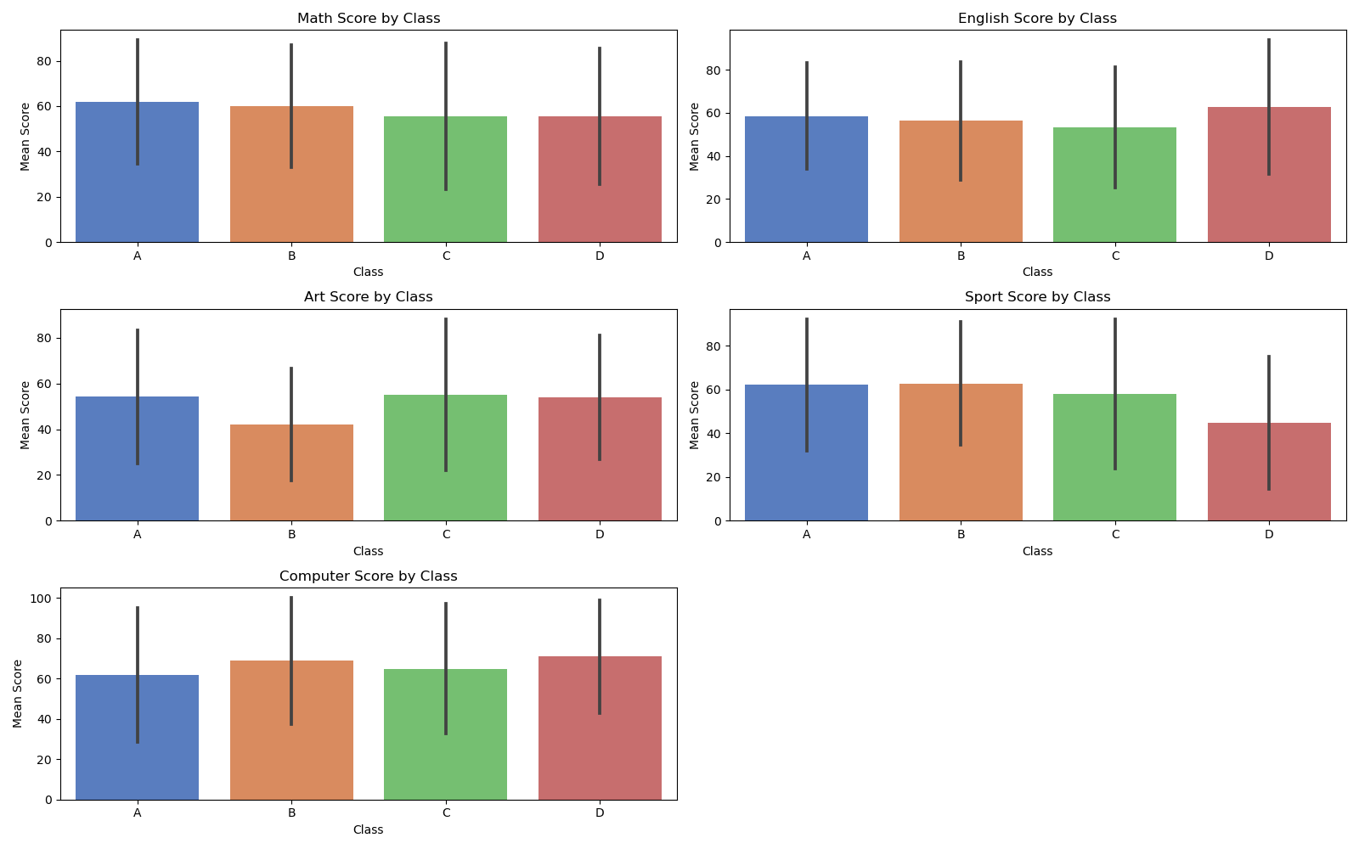
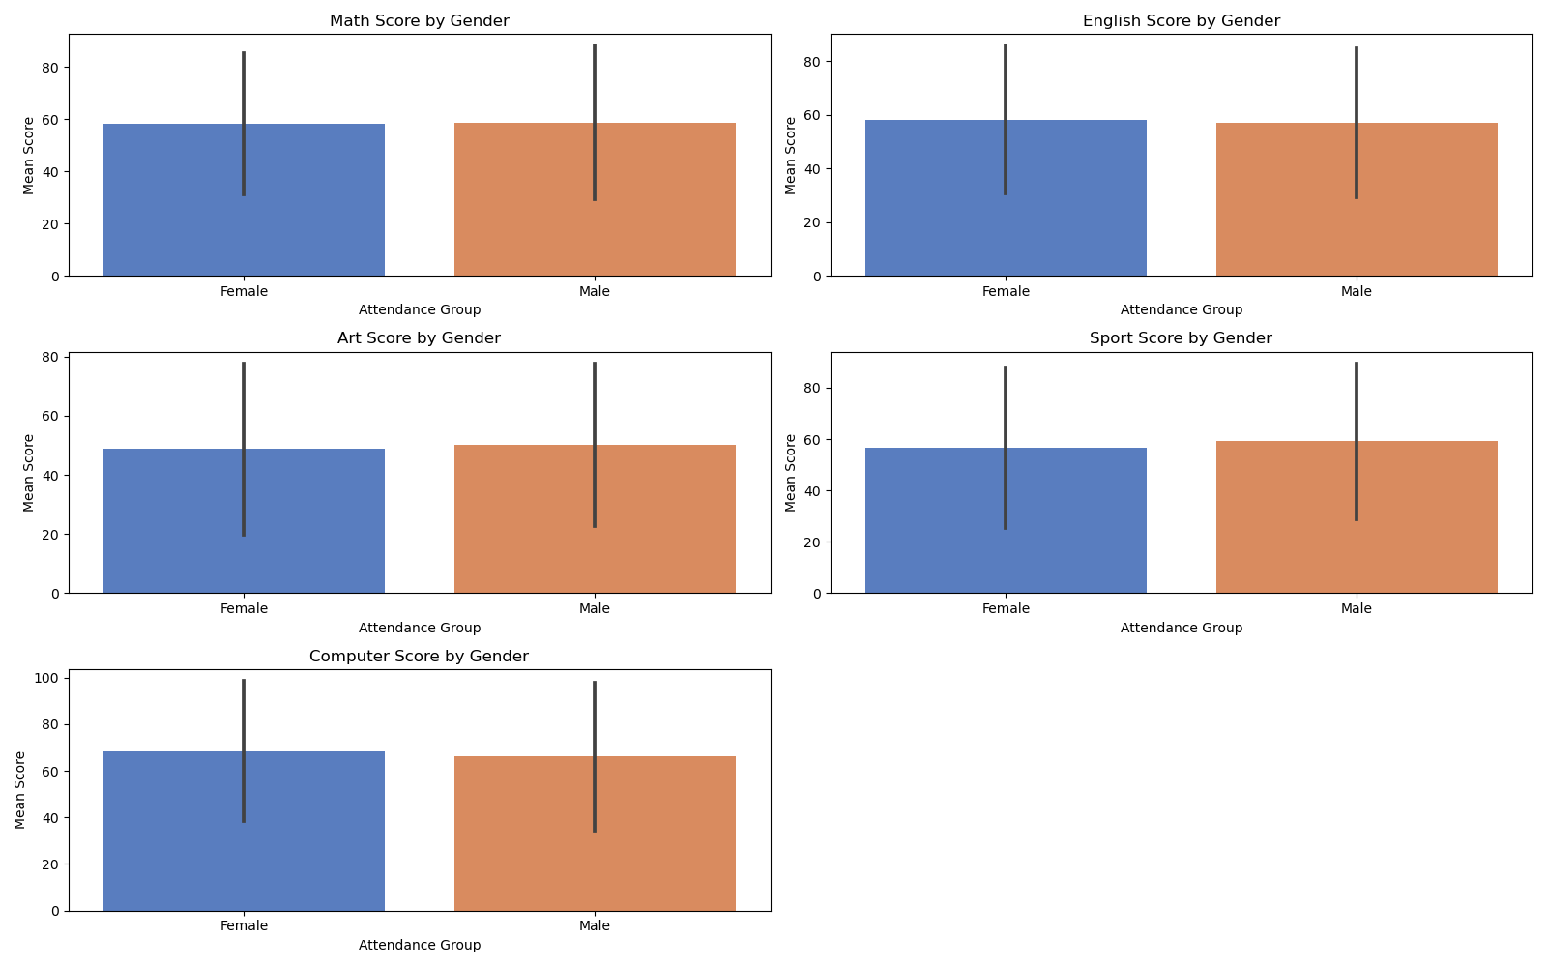
EXPLORATORY DATA ANALYSIS (EDA) - 2
Key Findings
Fig. 4
Fig. 5
Fig. 6
Class-Based Performance: Class performance shows variability, with Class A excelling in Math, while Class D leads in English.
Age Impact: Performance trends indicate that age 17 is critical, with declines in scores for subjects like Math and Computer Science.
Gender Performance: Similar scores across genders.

Slide 9
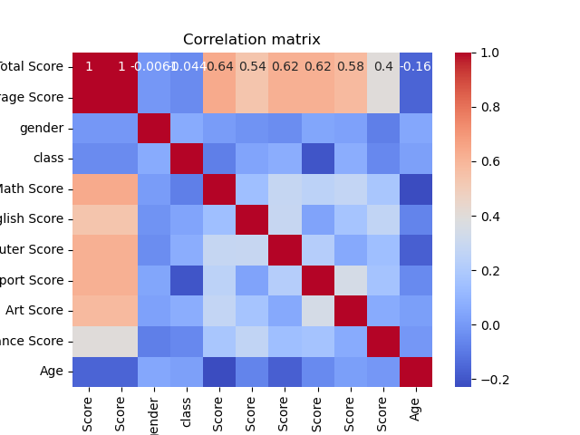
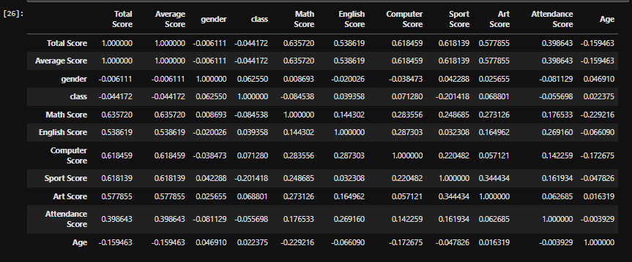
CORRELATION ANALYSIS
Correlation table
Findings:
Math: Highest correlation with overall performance.
Moderate positive correlation between student attendance and their subject scores,
Subject Correlations: Generally weak, indicating independent subject performance.
Age shows a weak negative correlation with scores, especially in Math and Computer Science

Slide 10
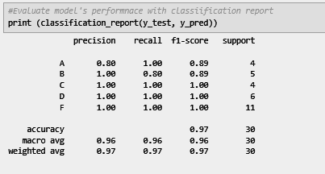
PREDICTIVE MODELLING
Model: Random Forest Classifier Performance:
Accuracy: 97%
Challenges: Lower precision and recall for grades A and B.

Slide 11


There is significant variability in performance within classes, indicating that tailored interventions may be necessary to support students based on their individual needs
CONCLUSIONS
Regular attendance is positively correlated with higher scores across all subjects, suggesting that improving attendance could enhance academic outcomes.
Performance trends vary with age, particularly noting a decline in scores for older students, which calls for targeted engagement strategies.
Math scores are the strongest predictor of overall academic performance, highlighting the need for focused support in this area.
For deeper insights, future analyses could explore factors like parental involvement and extracurricular activities. Expanding the dataset would also improve the reliability of findings.

Slide 12
Class A should focus on improving English performance, as it lags behind their Math scores, D, on the other hand, excels in English but needs to improve their Math scores., B has a higher number of students and a varied performance. It's important to assess this class individually and provide personalized interventions to close performance gaps.
PROBLEM STATEMENT
PROPOSED
SOLUTIONS
Students with lower attendance tend to perform worse, initiatives to increase regular attendance should be introduced.
Students showing signs of struggle, particularly in subjects like Math and Computer Science, should have personalized intervention plans. These can include one-on-one tutoring, etc.
Programs that will increase the engagement and motivation of the older student, such as career counseling, workshops on setting goals, and mentorship opportunities should be implemented.

Slide 13

TOOLS
&
TECHNIQUES
Python: For Coding and analysis
Pandas & NumPy:For Data manipulation and analysis
Matplotlib & Seaborn: For Data visualization
Scikit-Learn:For Machine learning models
Jupyter Notebook: Interactive coding and documentation

Slide 14
REFERENCES
Klein, M., & Sosu, E. M. (2023). School Attendance and Academic Achievement. International Journal of Social Sciences & Educational Studies, 97(1). Link
01
02
Serin, H. (2023). Teaching Mathematics: Strategies for Improved Performance. Link
Al Husaini, Y., & Shukor, N. S. A. (2023). Factors Affecting Students' Academic Performance. Arab Open University - Oman and UNISEL | Universiti Selangor.
03
04
Kaggle. (2024). Student Exam Dataset with Issues. Link

Slide 15

QUESTIONS
Feel free to ask any questions or share your thoughts.

Slide 16



THANK YOU
tiletiletoheebatyewande@outlook.com

